Slide 1

MEAM-520 Final Project
Particle Filter & Kalman Filter
Group 32
Bozhou Zha
Yongxin Guo

Slide 2
Background
Notes:
Let’s start from background

Slide 3

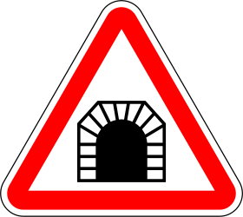

Situation 1
Drive a car with a non-standard tire pressure (Odometry is inaccurate)
Lots of tunnels, tall buildings and other poor signal area (GPS is unreliable)
Want to know a relative accurate position in real time
Notes:
Considering you are driving a car in Manhattan or Yellowstone Park. The odometer will not give you an accurate reading since the tire pressure is changing. The GPS cannot keep you updated all the time since the poor signal.

Slide 4
Situation 1
Drive a car with a non-standard tire pressure (Odometry is inaccurate)
Lots of tunnels, tall buildings and other poor signal area (GPS is unreliable)
Want to know a relative accurate position in real time
Trade off between inaccurate & unreliable?
Any better options?
Notes:
What would you do to localize yourself? How can you make full use of those two?

Slide 5
Situation 2
Sensor A: a very good one with high accuracy
Sensor B: an ordinary one
Sensor C: a terrible one with poor accuracy
A, B and C sensors can be of any domain, but measure the same physic unit
Notes:
The second situation. You have 3 sensors with different qualities. Good, normal and bad. And you want to measure something.

Slide 6
Situation 2
A: a good sensor
B: an ordinary sensor
C: a bad sensor
Which might be true?
Sensor A will give the best measurement.
Combination of A, B & C will give the best measurement.
Above are the same, since the worse sensors won’t contribute to the measurement done by the best one.
Notes:
Use the best sensor solely or combine them together? Will the combination with the bad sensor give you a better result? Or they work just the same?

Slide 7
2. Methods
Notes:
These are sensor filtering and fusion problems. We are trying to solve those by Kalman filter and Particle filters.

Slide 8
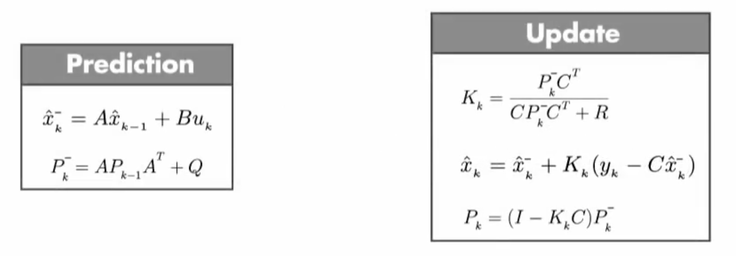
Method — Kalman Filter
Maximum Likelihood (ML) Estimation Approach
Good at sensor fusion
Initial state error proof
Immune to turbulence
Notes:
The Kalman filter is a good way to merge your action update, like the odometry, and perception update together.
The sensing error will not accumulate since the algorithm keeps refreshing the belief and the estimation as the iterations move on.
Surprisingly, even though the assumption of the initial status is wrong or the perception get lost in the middle way, the filter can still drag the estimation back to where it supposed to be.

Slide 9
Method — Particle Filter
Given Sample Particles N
|
Update N particles with action equation
|
Get the N measurement from N particles
|
Compare with the true measurement to get the weight
|
Resampling the particles based on the weight
|
Iterate again
One important Key: There are different resampling methods exist for different specific tasks
One unique feature: Good at nonlinear and multi-dimensional tasks.
Noise at action and measurement are all Gaussian-based model Randn(mean, variance)

Slide 10
3. Results

Slide 11
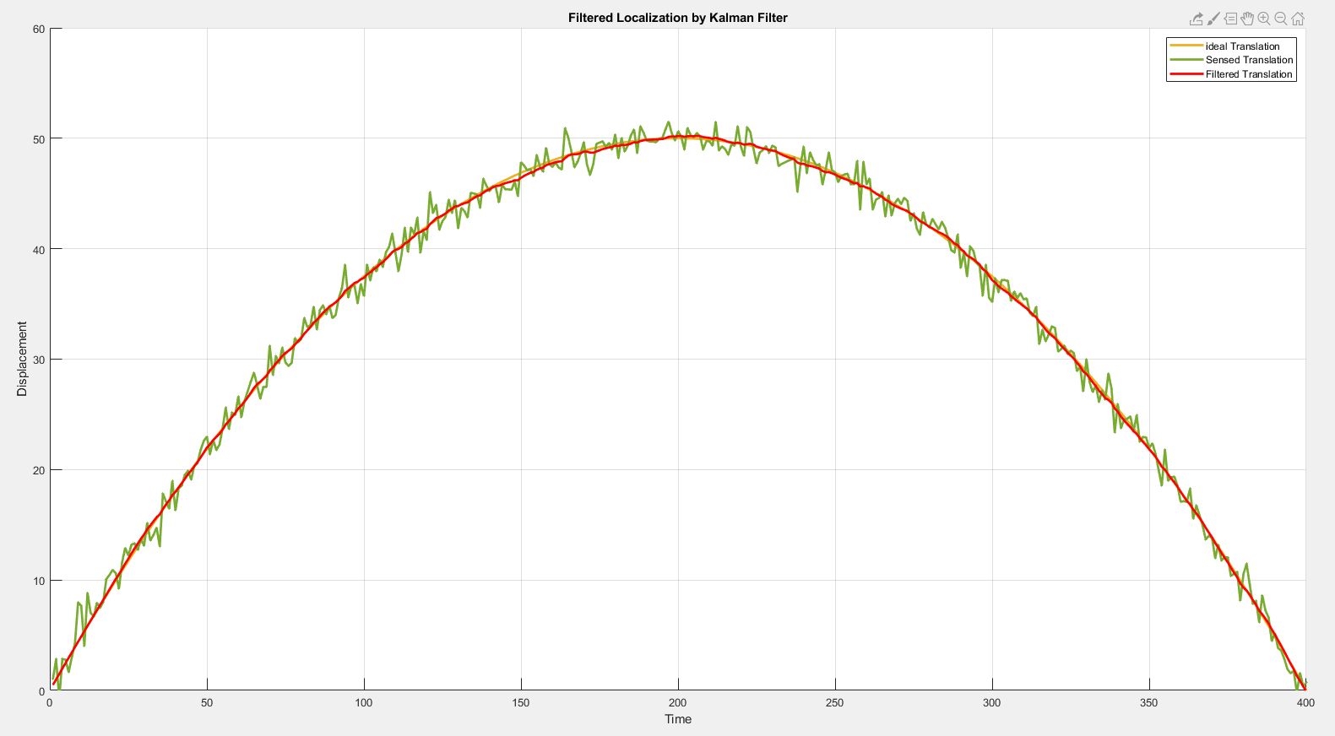
Kalman Filter —— 1D case
Notes:
The sensed data is quite noisy but the filtered red estimation curve smooths out the peaks and almost overlap with the ideal line, which represented in orange.

Slide 12
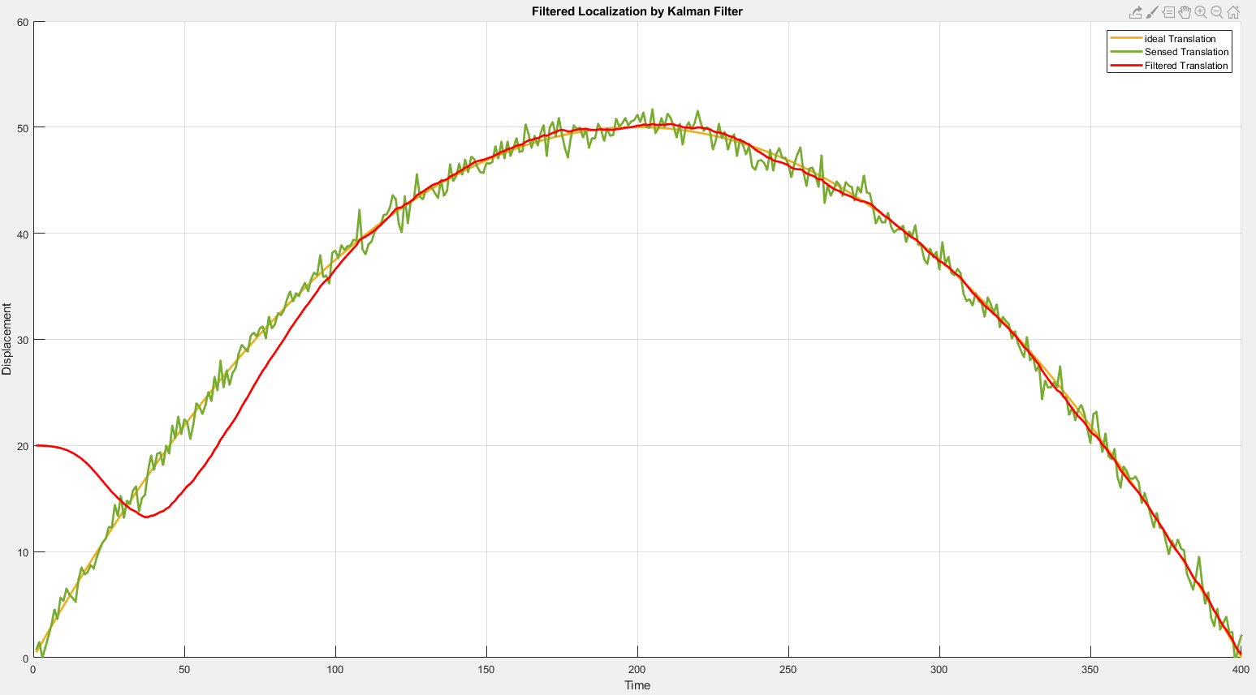
Kalman Filter —— 1D case with kidnapped initial state
Notes:
Here is the example of kidnap. As you can see, the start point of the red line is away from the 2nd order curve, but kalman filter drag it back as iterations move on

Slide 13
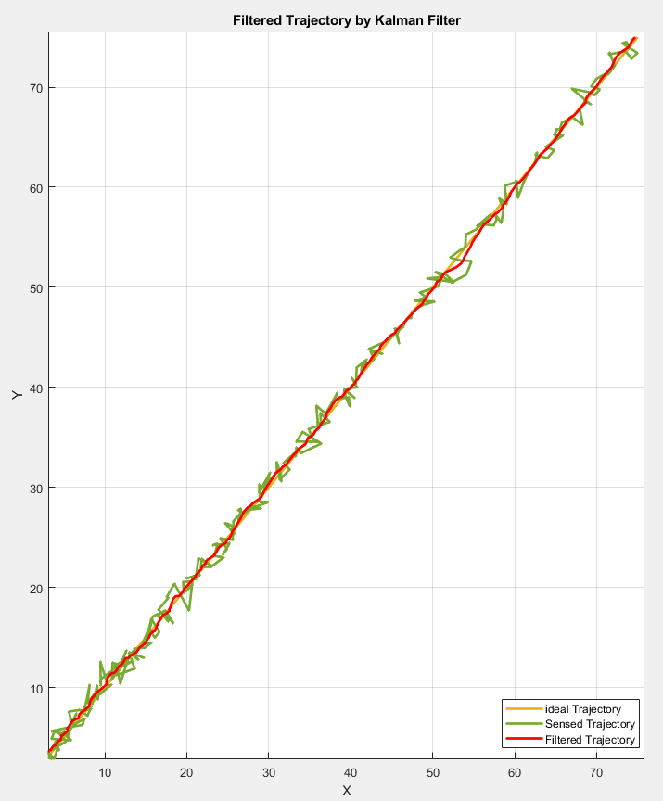
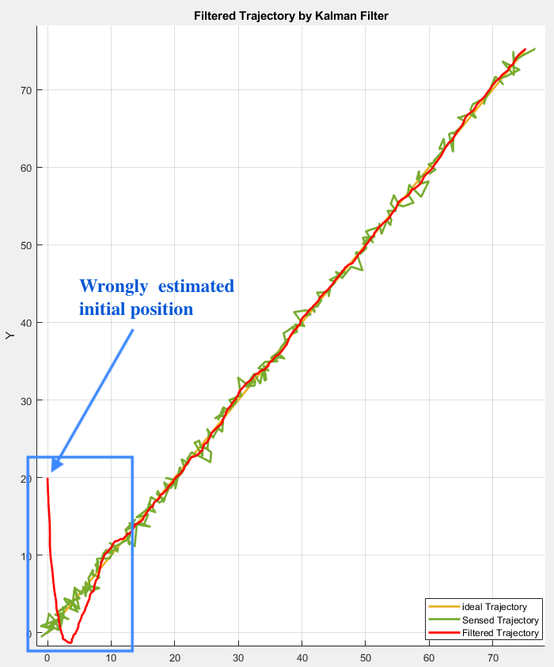
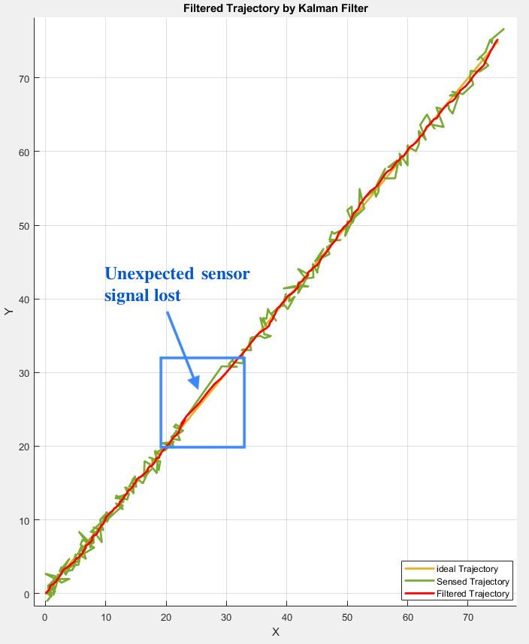
Kalman Filter —— 2D / 2D kidnapped / 2D signal lost
Notes:
In 2D cases, especially focus on the third case, the sensor stopped working in the half-way but the predicted red line still approximately sticks to the theoretical trajectory.

Slide 14
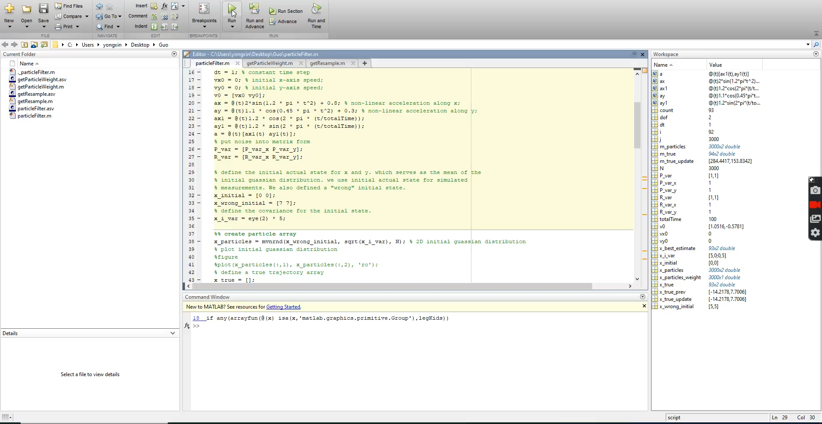
Particle Filter —— Nonlinear Acceleration for Point Robot

Slide 15
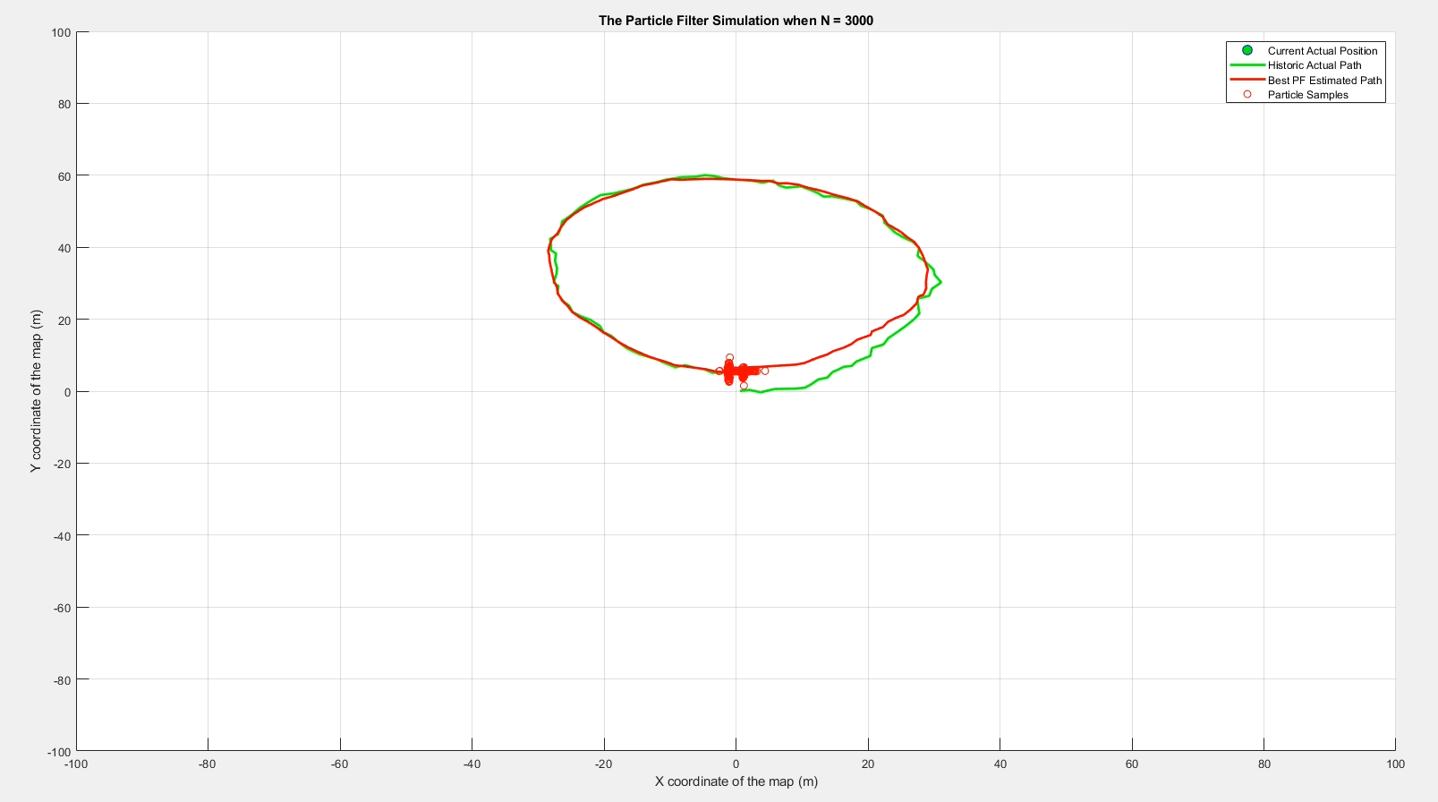
Particle Filter —— Nonlinear Acceleration for Point Robot

Slide 16
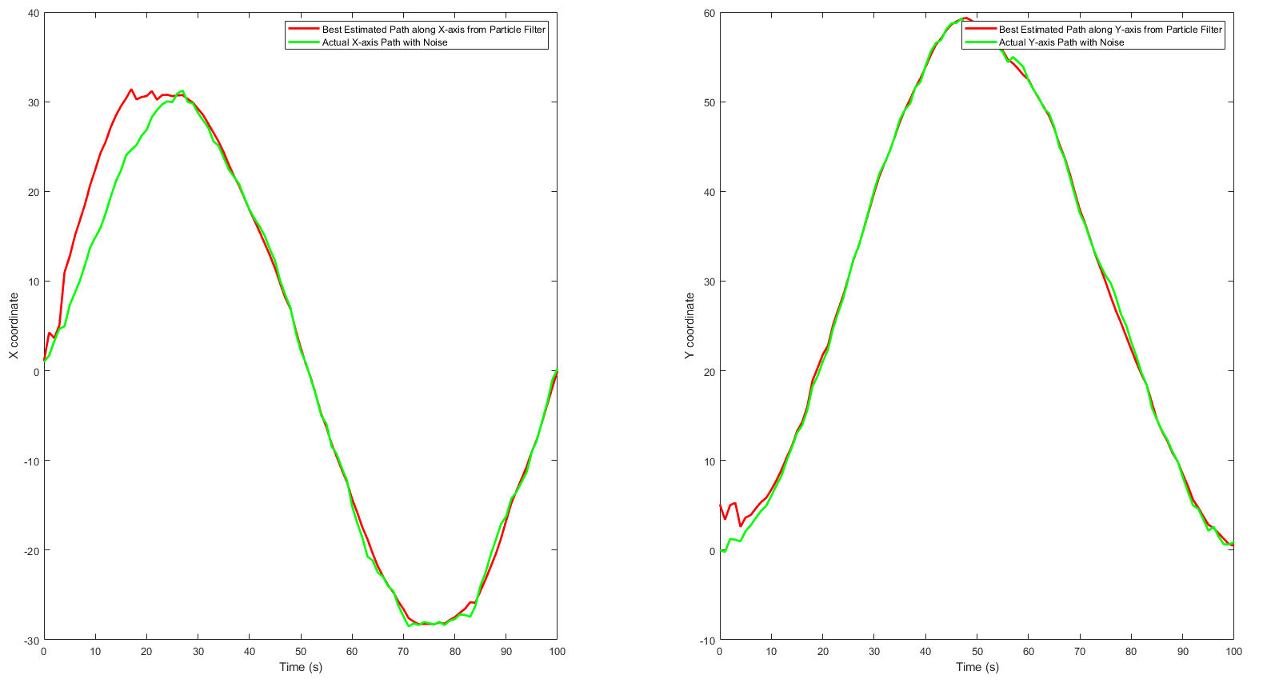
Particle Filter —— Kidnap Case
Kidnap Position

Slide 17
4. Challenges / Lessons Learned

Slide 18
Kalman Filter
Challenges / shortcomes
Improvement
Linear system only
Discrete system only
Gaussian distributed noise only
Convergence is not fast enough for rapid change system
Extended Kalman Filter
Combined with Particle Filter
Notes:
Kalman filter can only work on linear discrete system, and normally distributed noise. As prospective, we may use the extended Kalman filter instead.

Slide 19
Particle Filter
Challenges / shortcomes
Improvement
Resampling method determines the quality of particle filter
Lack of Diversity - particles are easy to congregate since the resampling method is actually a process of positive feedback for samples.
Try different resampling methods or combine different resampling methods dynamically.

Slide 20
Acknowledgment
“Introduction to Autonomous Mobile Robots”, Roland Siegwart et al
http://greg.czerniak.info/guides/kalman1/
‘‘Kalman Filtering’’, Prof. Mohan Krishnan, Univ. of Detroit Mercy

